Slide 1
Resume Analysis Tool
Notes:
Good morning everyone! Let’s dive into something that’s close to every recruiter’s heart—resumes. Today, I’m here to introduce our Resume Analysis Tool, designed to make this process smoother, faster, and maybe even enjoyable

Slide 2
THE PROBLEM WE ARE SOLVING
Unstructured Data
Lack of insightful Filtering
Time-Consuming Resume Screening
AUTOMATION
CONSISTENCY
INSIGHTFUL MATCHING
Extracts and analyzes text from resumes quickly and efficiently.
Identifies and processes skills, education, and industry keywords systematically.
Highlights candidate strengths, detect gaps, and aligns profiles to job/industry needs.
Notes:
We’ve all heard it: ‘There’s not enough time in the day.’ And if you’re a recruiter, that’s even more true. Screening resumes is time-consuming, inconsistent, and often lacks insightful filtering. Add to that the unstructured formats of resumes is a challenge.
Our tool solves this by leveraging NLP for three things:
Automation: Extracting text from resumes faster than you can say ‘Applicant Tracking System.’
Consistency: Processing skills, education, and keywords systematically.
Insightful Matching: Aligning candidates to roles and industries with precision.
In short, it saves time, reduces manual errors, and makes recruiters’ lives easier.

Slide 3
Overview of the System Functionality
01
04
Text Extraction from PDFs
Education Level Detection
02
05
Preprocessing to standardize text
Industry Matching for Candidate Profiling.
03
Keyword Matching and Counting for Skills
Notes:
Now, let’s talk about the magic behind the scenes. Our tool is powered by five core functionalities:
Text extraction from PDFs.
Preprocessing to standardize messy data.
Keyword extraction and counting for skills.
Education level detection using regex.
Industry matching for tailored candidate profiling.
Think of it as a very efficient personal assistant who loves reading resumes—and never takes coffee breaks!”

Slide 4
STEP:1
Extracting Text from Resumes
load resumes from a directory
use PyPDF2 to read and extract text
Convert all text to lowercase for uniformity.
Notes:
Step one: We extract text. Sounds simple, right? But resumes come in all shapes and sizes—PDFs, fonts, layouts, you name it. Using PyPDF2, we pull all the text and normalize it to lowercase. Why lowercase? Because computers, unlike us, don’t appreciate the difference between ‘Python’ and ‘python.’

Slide 5


STEP:2
Preprocessing Text
Actions:
Remove newlines and double spaces.
Normalize text to lowercase.
Purpose:
Ensures consistent format across various resume structures, allowing for more accurate keyword matching.
Notes:
Next, we clean up the extracted text. Think of this as doing laundry for data:
We remove newlines and double spaces.
Normalize everything to lowercase.
This ensures the data is clean, uniform, and ready for further analysis. Because messy data and accurate results? They don’t get along.

Slide 6
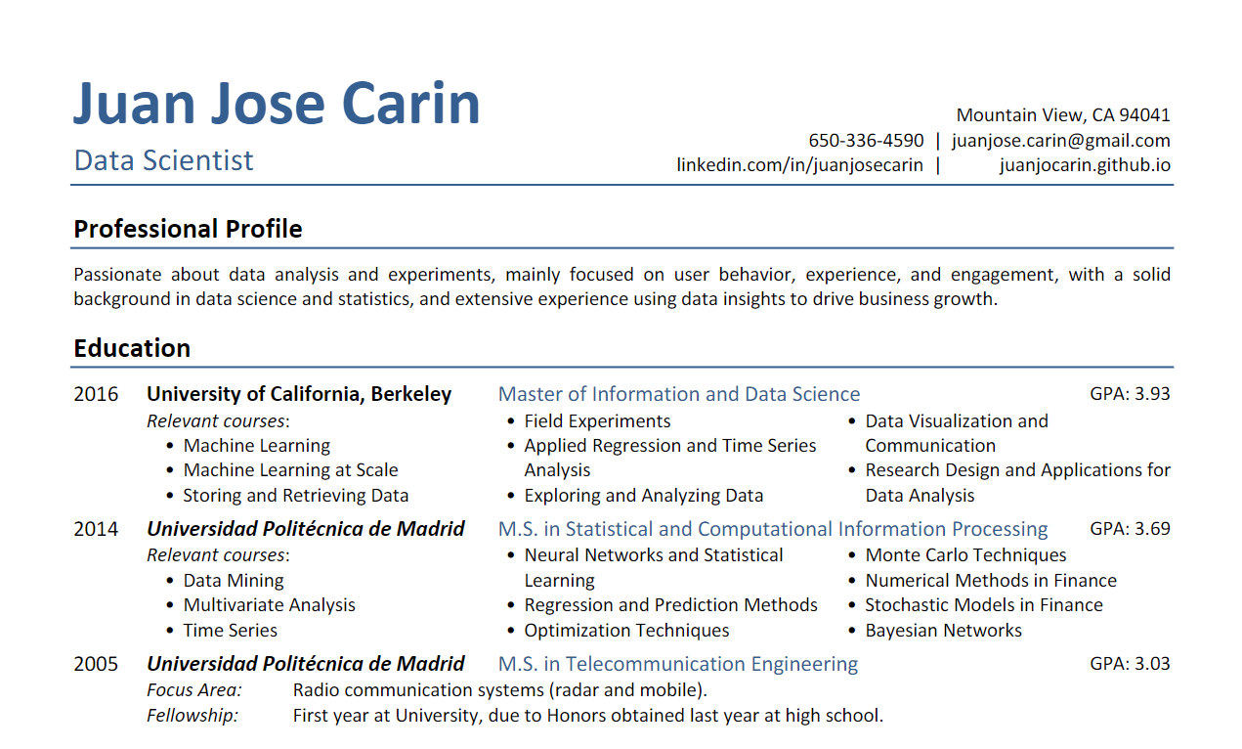
How Text analysis works
Notes:
Here is a sneak peak on working of text analysis, the program looks through the resumes and finds relevant skill as per the job description which are highlighted in yellow. And also after looking for skills, it will scan the resume for the education level detection, which is highlighted in red. we will talk more about this feature in further slides.

Slide 7
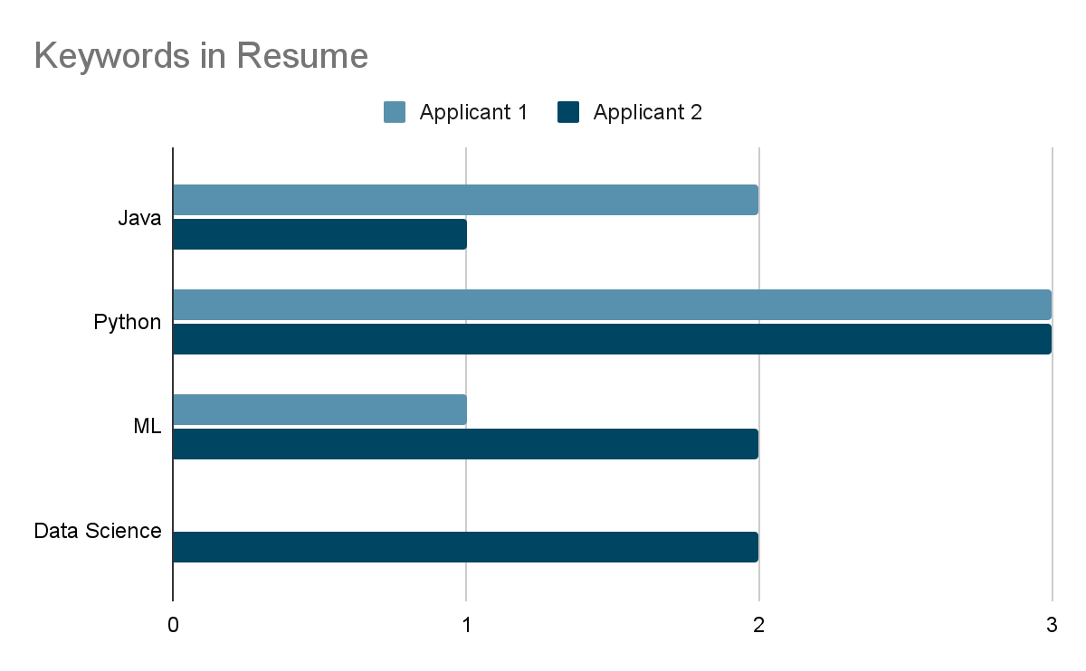
KEYWORD EXTRACTION
AND COUNTING
KEYWORD MATCHING
APPLICATION
Notes:
Here’s where the magic begins. Using regex, we extract keywords like ‘Python,’ ‘machine learning,’ or ‘data analysis’ and count their occurrences. So if a candidate says ‘Python’ five times, we know they really mean it. Also, we can compare all the extracted results of each candidate,

Slide 8
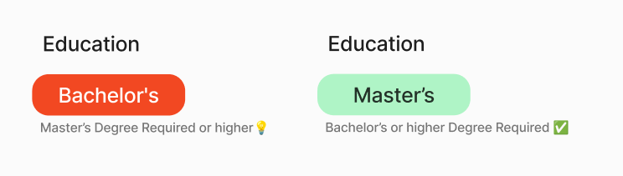
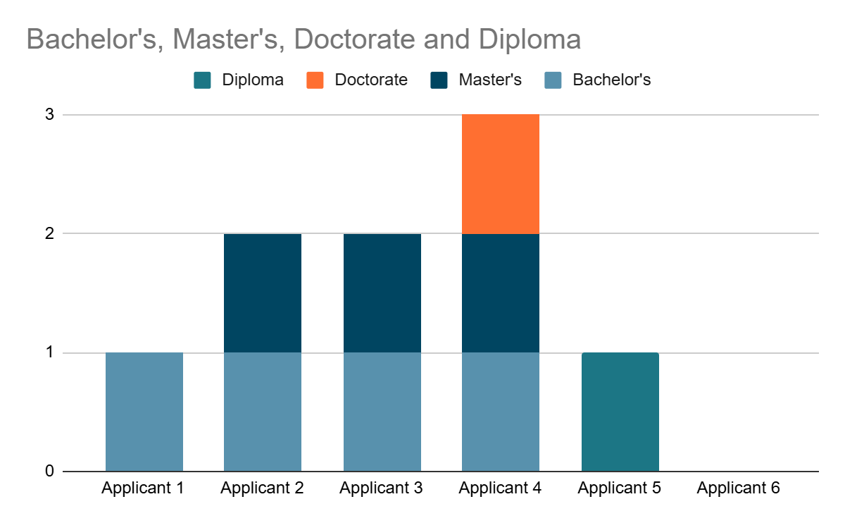
STEP 4 : EDUCATION LEVEL DETECTION
OUTPUT
PROCESS
GOAL
Return the education level or indicates if the minimum requirement is unmet
Define REGEX Patterns
Scan the text for each pattern in hierarchical order
Identify the highest level of education attained by the candidate
Notes:
Education can be a deal-breaker for many roles. Our tool scans the resume to identify the highest education level attained. Using regex, it detects phrases like ‘Bachelor’s,’ ‘Master’s,’ or ‘Ph.D.’, ensuring we don’t miss anyone qualified—or disqualify anyone unnecessarily. We can also compare the highest education level attained by a candidate with other candidates. Also, we can also highlight a candidate if he is eligible for the job or not.

Slide 9
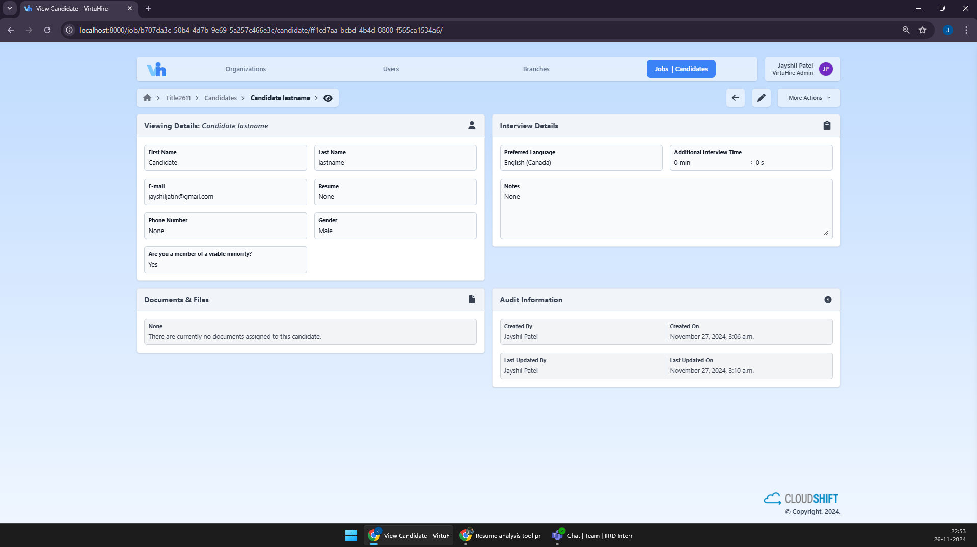
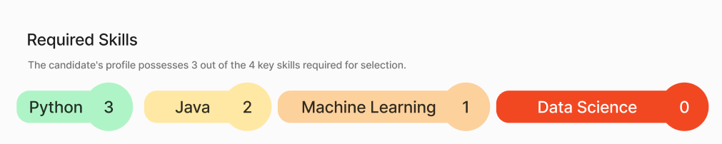
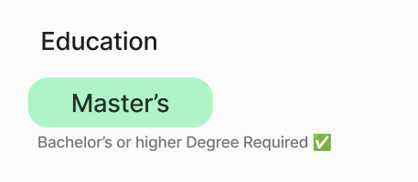
Notes:
Here is a sneak peak, of the feature on candidate’s info page. Here we can see that python was mentioned 3 times which is more than enough, even though data Science was a required skill, it was never mentioned in the resume.

Slide 10
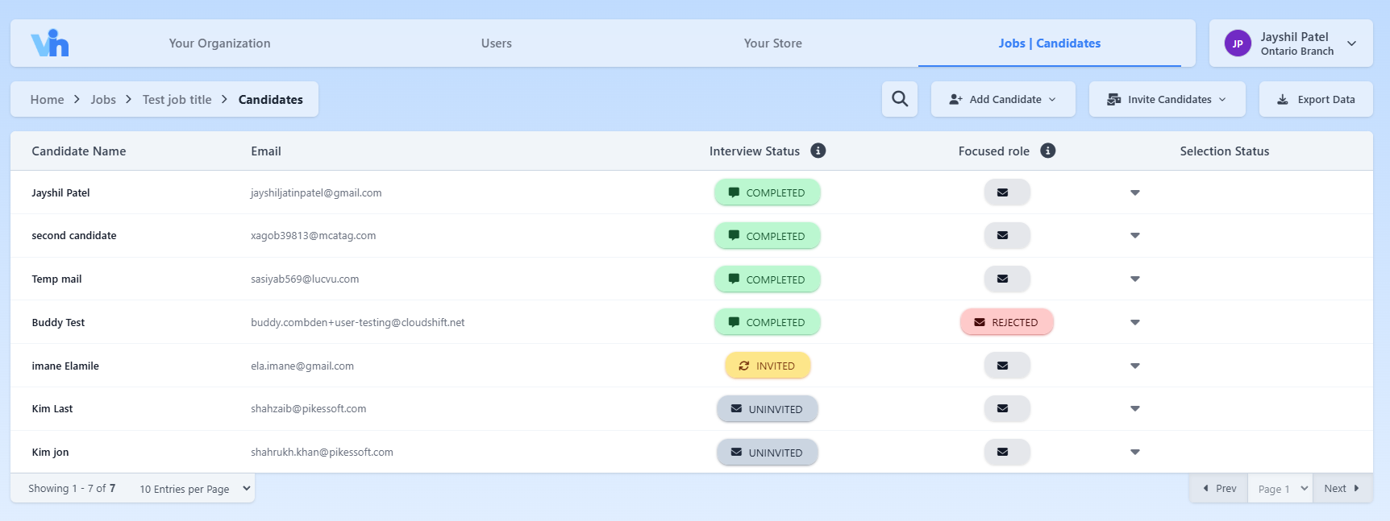







STEP 5 : INDUSTRY MATCHING
PURPOSE
METHOD
OUTPUT
Notes:
Here’s where it gets even cooler. We analyze the resume for keywords tied to specific industries. Think ‘data science,’ ‘software development,’ or ‘finance.’ Based on these matches, we recommend the industries where a candidate is most likely to shine.

Slide 11
Process of Integration
Frontend Development
Initial Setup
DEPLOYMENT
Backend Development
Testing and Optimization
Notes:
How do we bring all this power to your fingertips? Here’s the plan:
Backend development to build APIs for resume uploads and analysis.
Frontend development to integrate it into our platform.
Rigorous testing to ensure everything works like a charm.
Deployment, so you we start enjoying the benefits!

Slide 12
Benefits and Value Proposition
SCALABILITY
ACCURACY
EFFICIENCY
Can process multiple resumes at once, allowing companies to handle large applicant volumes.
Standardized keyword matching ensures relevant skills are highlighted.
Reduces manual resume screening time, particularly for large-scale hiring.
Notes:
So, why does this matter? Three reasons:
Scalability: Handles bulk resumes effortlessly.
Efficiency: Reduces manual screening time.
Accuracy: Standardizes results and highlights relevant skills.
In short, it’s like having a superhuman recruiter on your team

Slide 13



POTENTIAL IMPROVEMENTS AND FUTURE SCOPE
AI generated Summary / Score
FEATURES TIERS
Notes:
We’re not stopping here. Imagine AI-generated summaries, candidate scoring, and even smarter matching algorithms. The possibilities are endless. With this tool, we’re laying the foundation for something transformative.

Slide 14
THANKS!
Does anyone have any question?
Notes:
That’s the overview of our Resume Analysis Tool. I’d love to hear your thoughts, questions, or ideas. And if you want to test it live, I’m happy to dive into that too. Thank you for your time—and for letting me nerd out about resumes today!

